Slide 1
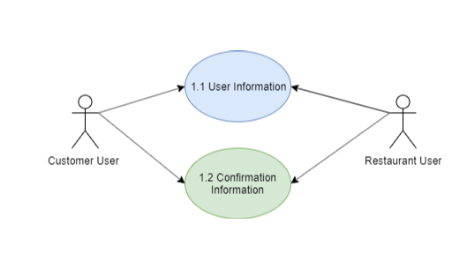
Use Case Diagram
Super Servoli Systems
Use Case Diagram
Module: 01. Register

Slide 2
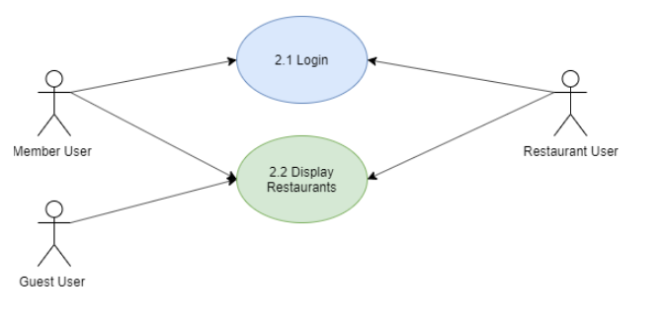
Use Case Diagram
Super Servoli Systems
Use Case Diagram
Module: 02. Reservation/Menu

Slide 3
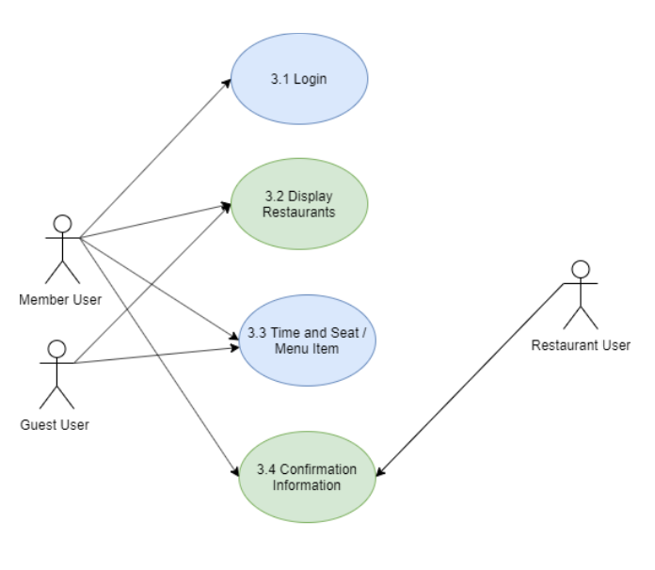
Use Case Diagram
Super Servoli Systems
Use Case Diagram
Module: 03. Make Reservation

Slide 4
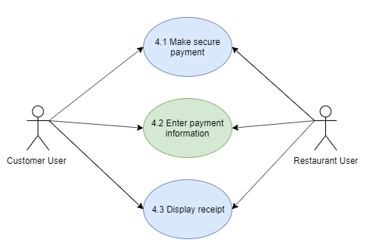
Use Case Diagram
Super Servoli Systems
Use Case Diagram
Module: 04. Make Payment

